Slide 1
More information
Partitions and methods

Slide 2
Partitions
You can think of a partition as a piece of our dataset that can process independently.
Its also good to know that partitions are processed in parallel across a cluster, so more partitions means more parallelism.

Slide 3
Partition methods
Shuffle – When we decrease/increase the number of partitions in our code, a shuffle can occur. A shuffle is an expensive operation that will redistribute our data among partitions.
Coalesce – Use when decreasing partitions (no shuffle needed)
Repartition – Use for increasing partitions (requires shuffle)
Partition By- Use when we want a custom partition based on a key – value RDD. It optimized joins/groupbys.

Slide 4
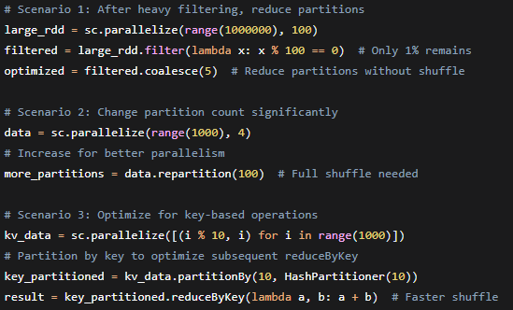
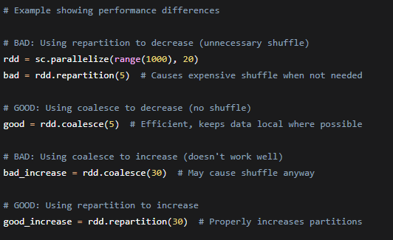
Example code

Slide 5
Working with Parquet Files
We use the exact functions we learned to decide the data structure of our parquet files.
PartitionBy can be used when deciding the directory structure of our parquet when inserting a dataframe.
We also use coalesce and repartition for file size management. Coalesce makes it more efficient by avoiding a shuffle by merging partitions, and repartition will increase partitions to make sure data is evenly distributed for writing. This causes a shuffle so it's more expensive.

Slide 6
Partitions vs Bucketing
Partitions and bucketing are similar because they both aim to increase the performance of our big data operations.
Partitions are effiecient when you will be querying and want efficient resource utilization. Best used when there are not many distinct values.
Bucketing is when we have a set number of buckets we use to distribute data evenly, using a hash function on a specified column. This ensures that records with the same key are always grouped in the same bucket. Bucketing will speed up joins and GroupBy operations by minimizing expensive shuffles.

